Slide 1
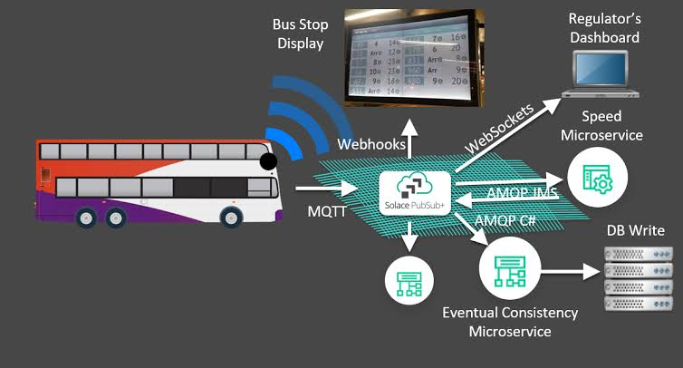
PUBLIC TRANSPORT OPTIMIZATION

Slide 2
PUBLIC TRANPORT OPTIMIZATION
Public transport optimization refers to the process of improving the efficiency, effectiveness, and overall quality of public transportation systems. This involves using various strategies and technologies to make public transportation more convenient, reliable, and environmentally sustainable.

Slide 3
IOT Projects in Public Transport
Explore a range of fascinating IoT projects that have been implemented in public transport systems, including smart ticketing, real-time passenger information systems, and automated fleet management.

Slide 4
The Importance of Predicting Arrival Time
Learn why accurately predicting arrival times is crucial for passengers, operators, and city planners. Discover how IoT-powered algorithms and data analysis techniques can help optimize scheduling and reduce delays.

Slide 5
Data Collection and Analysis Methods
Sensor Integration
See how IoT sensors collect real-time data on vehicle locations, passenger counts, and traffic conditions to feed into predictive models.
Machine Learning
Discover how machine learning algorithms can be trained on historical data to recognize patterns and predict arrival times with greater accuracy.
Big Data Analytics
Explore the use of advanced analytics techniques to process and analyze massive datasets, unlocking valuable insights for optimizing public transport operations.

Slide 6
Development of Prediction Models
Supervised Learning
Understand the process of training prediction models using labeled data, enabling them to make accurate forecasts based on past patterns.
Time Series Analysis
Learn how statistical techniques can analyze historical data to identify temporal patterns and seasonality, facilitating precise arrival time predictions.
Neural Networks
Explore how artificial neural networks can leverage the power of parallel processing and hidden layers to create more sophisticated prediction models.

Slide 7
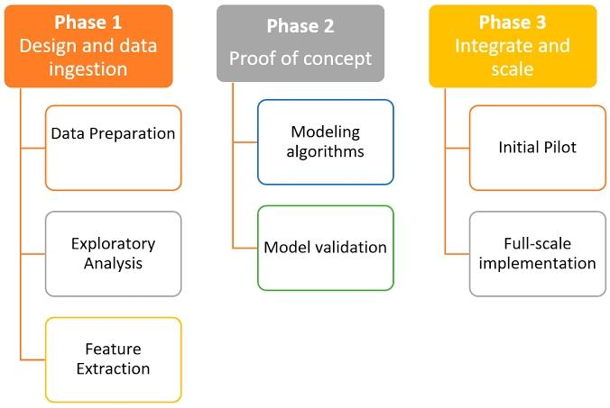
Integration of Prediction Models

Slide 8
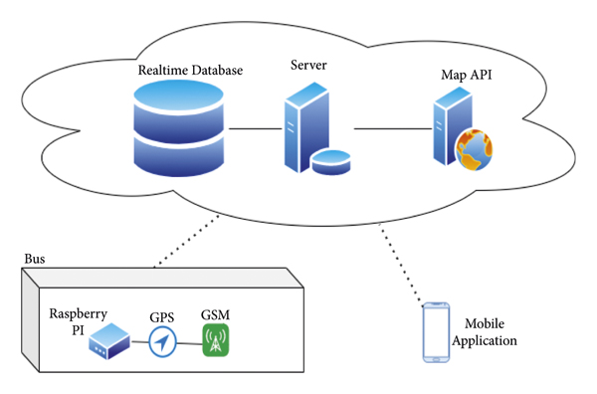
Location Provider Module

Slide 9
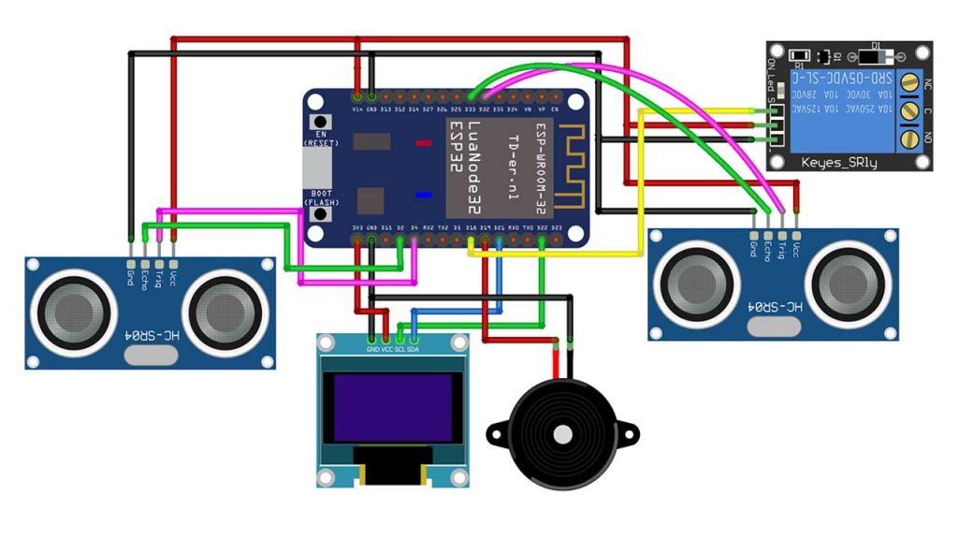
Passenger Count

Slide 10
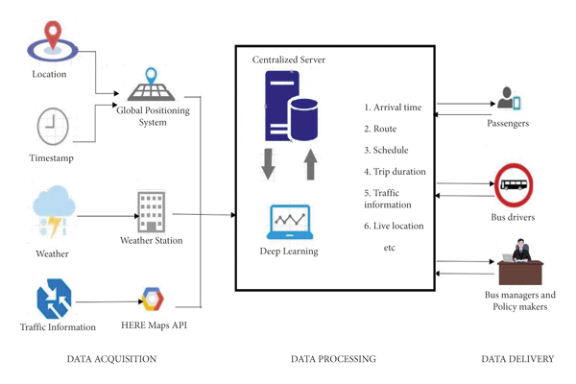
Control Flow

Slide 11
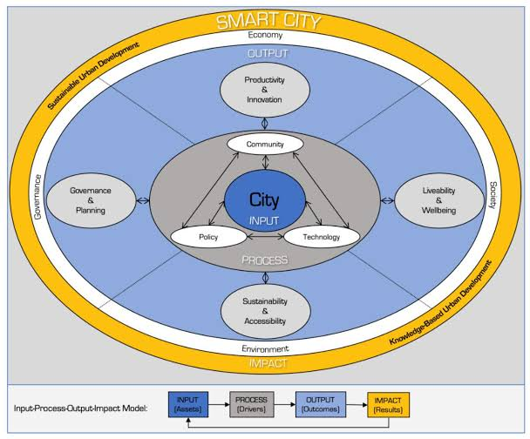
Smart Mobility

